Slide 1
Health Technology
Presented By:
Date:

Slide 2
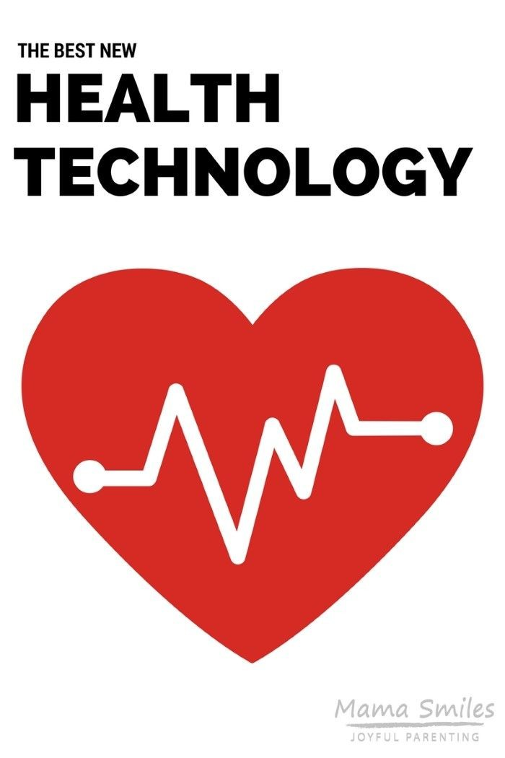
HEALTH
World Health Organization (2000) define health as the state of being free from diseases whether physical, mental, as well as social well-being. There are many ways in which medical practitioners try to improve people’s health through medical treatments and interventions.

Slide 3
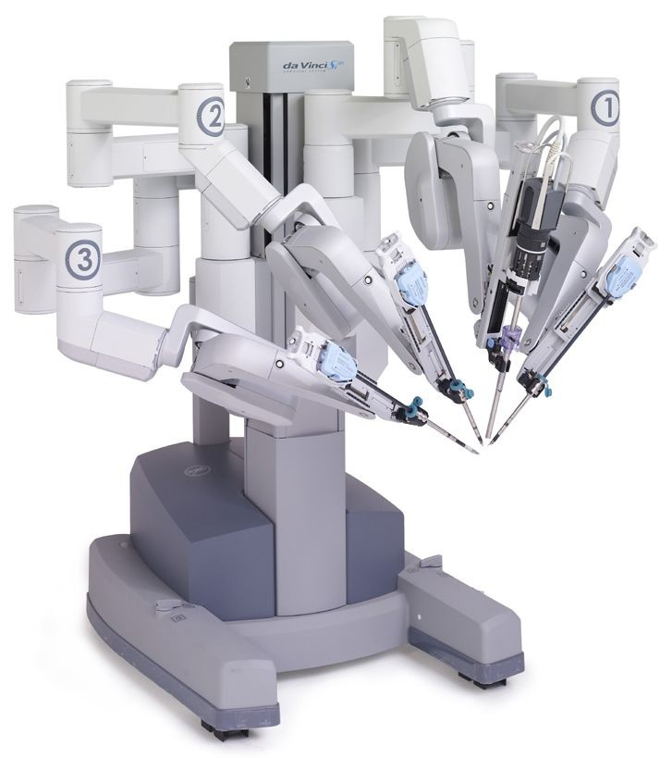
Technology
Technology is the advanced knowledge or skills integrated in a specified field to improve processes involved in that field. Innovation is key to the medical technology industry. Innovation delivers better lives for patients, more efficient healthcare system (National Center for Health Statistics (US.), 2010).
In addition, medical technology involves a series of tools and devices used to operate on a patient, detect diseases, and ensure that patient’s health improvement is followed up when the patient goes back to the community.

Slide 4
Health Technology
According to Groves et al (2013), recent advances in technology has ushered a new era of healthcare. Fundamentally, they continues to change how medical decisions are made and how medical professionals choose treatment options. However, health technology entails the integration of knowledge in the form of medicines, devices, procedures, and systems, which are developed to solve certain health problems and with an aim of improving peoples lives.
Medical technology breakthroughs are building from the incredible progress made in Nano Technology, Biotechnology, Computers, the Information learned from deciphering the human genome and other scientific and technical areas (Groves et al., 2013).

Slide 5
Types of Health Technologies
Health monitoring technologies
Diagnostic Imaging
Unified communications within the hospital setting
Data Analytics just to mention, but a few.
This presentation focuses on health monitoring technology- (ECG Remote Monitoring)

Slide 6
Background Information
Many people, especially, those suffering from chronic diseases such as heart diseases are more likely to die from complications more so when they are away from hospitals. An alternative to frequent clinical check-ups is patients using wearable and other personalized technologies to receive a variety of automated data that is essential in monitoring one’s status of health.
Remote monitoring of patients is crucial in improving healthcare provision. It reduces risks associated with immediate symptoms e.g. arrhythmia in patients suffering from heart diseases. This presentation focuses on electrocardiogram technology and the use of ECG wearable devices that are currently used as alternatives for checking patient’s ECG remotely.

Slide 7
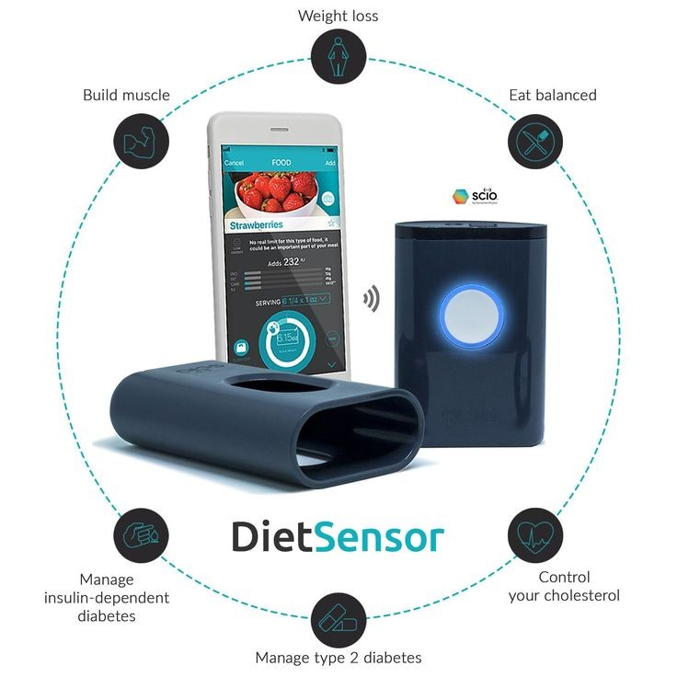
Health Monitoring Technologies
Personal health monitoring technology represents such a further step in technological and societal evolution. An increasing number of technologies are developed to help patients monitor their health in a wide range of spectrum. This includes new health-related technologies, such as smart home solutions, sensor-equipped assistive technologies, products for activity and weight monitoring, direct measurement of health-related parameters such as ECD, blood pressure or blood glucose.

Slide 8
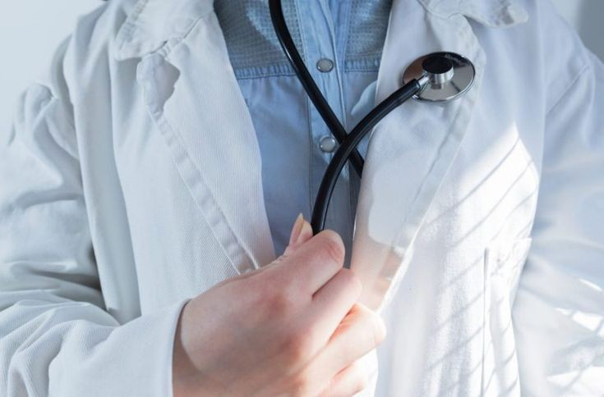
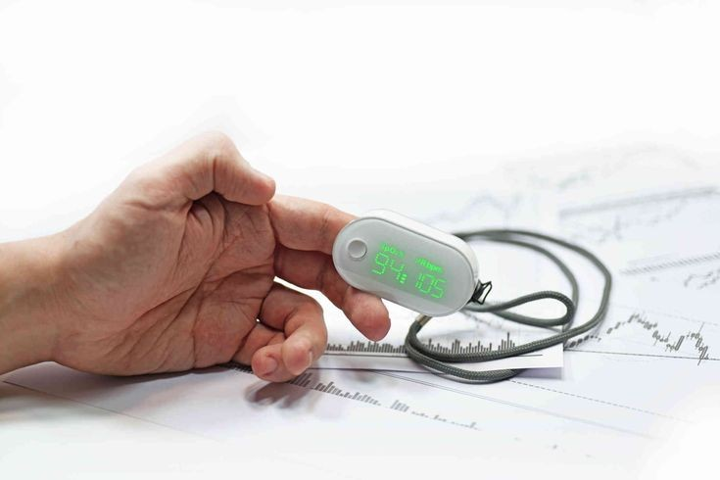
Healthcare Providers
Less than a decade ago, HEALTHCARE PROVIDERS begun to recognize the importance of using advanced technology to MONITOR the health of their patients remotely.

Slide 9
Wearable Devices
At first wearable devices were used to track how much calories individuals took, their steps when doing exercises and so forth. Today, wearable devices are being used as medical devices and accessories to monitor health of patients even when they are at their homes.
The devices are worn on wrists or any other part of the body to monitor one’s health and detect any signs of illnesses. For example, the Apple Watch is used to take an electrocardiogram, which in the past required patients to go to the hospital for it to be taken.

Slide 10
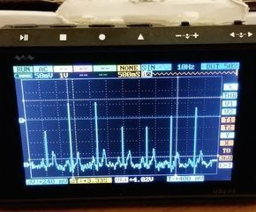
Electrocardiogram Technology
Background Information
Electrocardiogram (ECG) was developed by Alexander Muirhead to measure electrical activity of the heart in patients suffering from various heart diseases (Burnett, 1995). The device helped in daily monitoring of ECG. It helped capture daily heartbeat and other related abnormalities e.g. acute angina, myocardial ischemia, arrhythmia, which were all difficult to capture during occasional clinic visits.
This paved way for an innovative development of new ECG devices that help in monitoring symptoms which medical practitioners assesses or analysis in order to provide the best treatment option for cardiovascular diseases.

Slide 11
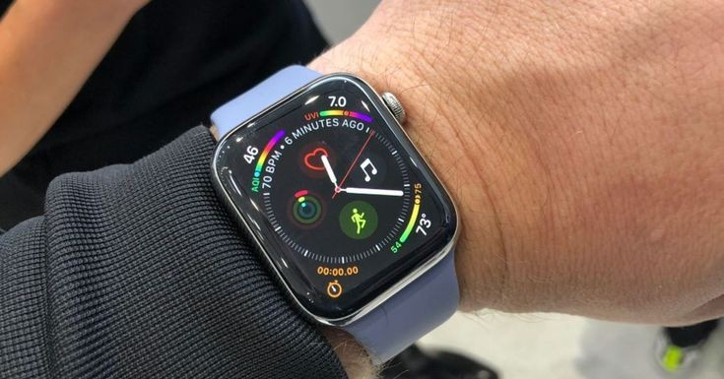
(Wearable ECG Recorder)
Wearable ECG Recorders are now assisting doctors assess their patients even more easily. In the past, ECG was used in hospitals to assess cardiovascular functioning.
Recent technologies that include some improvements in HRV (heart rate variability) help medical practitioners obtain more information even when the patients are going on with their daily lives outside the hospital.
Cardiac Event Recorder is the most accurate device used to diagnose arrhythmia

Slide 12
What is arrhythmia?
It is a problem with the rate of rhythm of the heartbeat. During the arrhythmia the heartbeat can be too fast or slow. This heart problem affects 2.0% of the United States population. The problem can be very dangerous and contributes to approximately 500,000 deaths in the United States each year.
This issue is more common among individuals who are at high risk of developing cardiovascular diseases. It occurs immediately and there is no easy way to get ECG data at the same time. Usually, it is a major issue causing doctors not to be unable to make any effective diagnosis (Solosko et al., 2017).

Slide 13
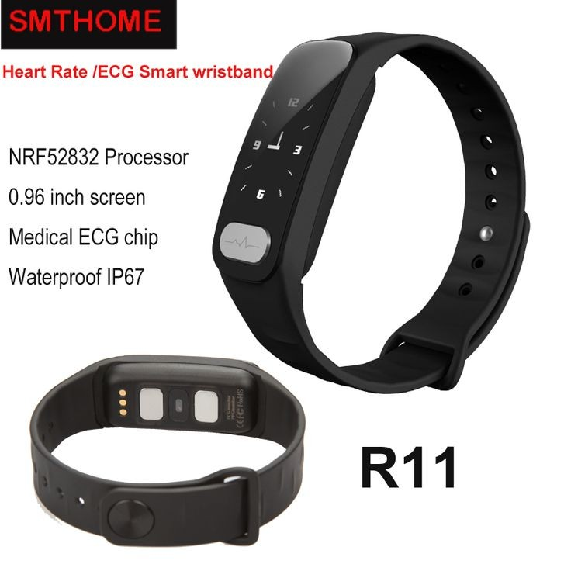
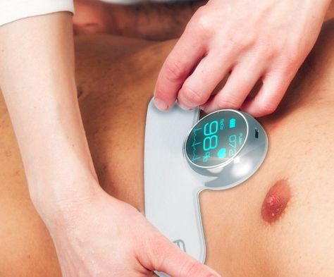
How does wearable ECG recorder help in healthcare?
Due to occurrence of immediate symptoms and not being easy to measure ECG data at the same time, patients suffer from multiple and inconvenient medical processes.
Wearable ECG recorders help track and measure ECG data even more easily. Patients are expected to wear the ECG monitor on their bodies so as to track their ECG data. The doctor uses this data to assess patient’s health status and offer effective treatment options.

Slide 14
Financial Implication
Outpatient cardiac monitoring is costly especially if the patient is a higher risk of suffering from atrial fibrillations. Wearable ECG devices can reduce the cost of monitoring as patients are only required to wear the device and remotely monitor vital signs that would indicate a heart problem. The idea here is that the cost of treating heart diseases is rising at an alarming rate and wearable devices can help reduce these costs.
While ECG monitoring is costly, ECG wearable devices are less costly. For example, Apple ECG Watch costs between $399 and $499. This is a clear indication that anyone at high-risk of developing a heart disease can afford to purchase it.

Slide 15
Ethical Concerns
Low income earners or the poor are more likely to die prematurely from heart diseases. We cannot deny the impact health technology has on people’s health. Costly health technologies tend to widen the gap that exists in access to healthcare. Low income earners or the poor cannot afford costly healthcare technologies. This raises some ethical concerns related to unequal access to healthcare.
To close the existing gap, health technologies should be provided at affordable costs so that every individual can have access to it.

Slide 16
Meaningful Use of Health Technology
As the society and pressures increase, healthcare providers as well as patients need to embrace emerging health technologies in order to offer the best care and improve their health.
Healthcare providers should use health technology to detect, treat, and monitor symptoms that flare out without warning.
Clinicians should use recent health technology to be proactive and offer personalized advice, treatment options, and preventive care to their patients.
Using clinical and operational analytics technology, medical practitioners can get real-time insights from data collected from their patients during regular check-ups including vital signs, lab results, and even unstructured data from remote monitoring systems.

Slide 17
References
Burnett, J. (1995). The origins of the electrocardiograph as a clinical instrument. Medical History, 29(S5), 53-76.
Groves, P., Kayyali, B., Knott, D., & Van Kuiken, S. (2013). The ‘big data’ revolution in healthcare. McKinsey Quarterly, 2(3).
National Center for Health Statistics (US. (2010). Health, United States, 2009: With special feature on medical technology.
Pantelopoulos, A., & Bourbakis, N. G. (2010). A survey on wearable sensor-based systems for health monitoring and prognosis. IEEE Transactions on Systems, Man, and Cybernetics, Part C (Applications and Reviews), 40(1), 1-12.
Solosko, T., Gehman, S., Herleikson, E., Lyster, T., Fong, S., Hansen, K., ... & Mauser, C. (2017). U.S. Patent No. 9,615,793. Washington, DC: U.S. Patent and Trademark Office.
World Health Organization. (2000). The world health report 2000: health systems: improving performance. World Health Organization.

